Slide 1
NORTH SOUTH UNIVERSITY
DEPARTMENT OF ELECTRICAL & COMPUTER ENGINEERING
CSE499B.5:SENIOR DESIGN II
Project Presentation Slide
Medical Deepfake Prediction Using Deep Learning (False Cancerous Image Detection)
By,
Gulam Sarwar
1821700042
Rafid Ahmed
1831395642
Submitted To,
Dr. Mohammad Monirujjaman Khan(KMM)

Slide 2
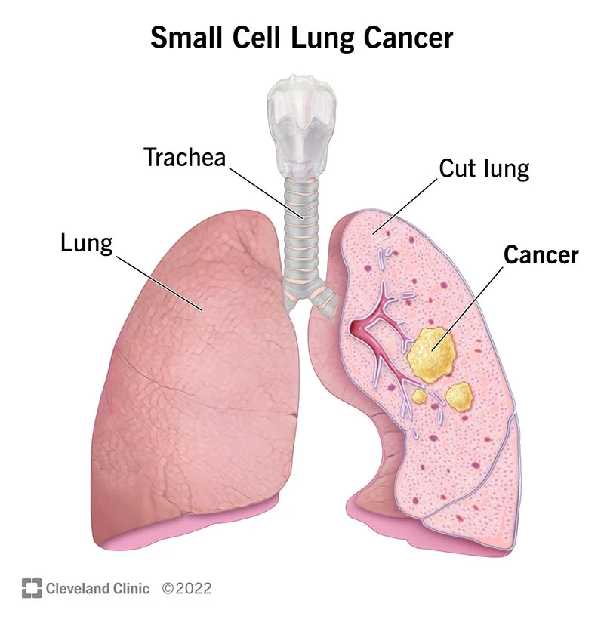
Background
Lung cancer is a type of cancer that begins in the lungs. Our lungs are two spongy organs in your chest that take in oxygen when we inhale and release carbon dioxide when we exhale.
Deep learning is a machine learning and artificial intelligence (AI) technique inspired by human learning. Data science, which covers statistics and predictive modeling, contains deep learning as a major component.
We have applied VGG16(Sequential) model. VGG16 is a convolutional neural network(CNN) model that's used for image recognition.. For performance analysis we will use confusion matrix such as true positive, true negative etc. For datasets we used kaggle.

Slide 3
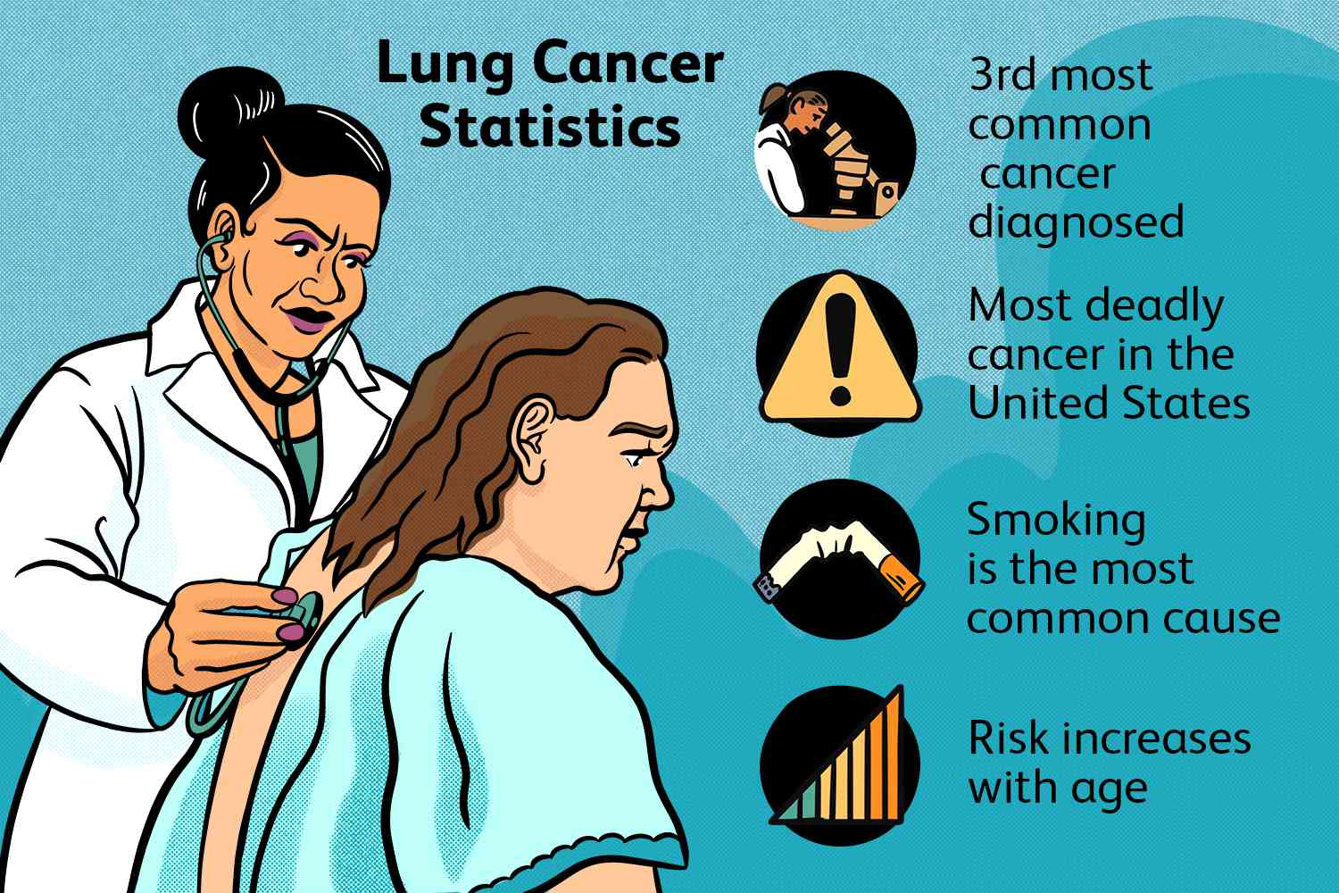
Problem Statement
Lung cancer at early stage if can be detected than the survival chance gets high. Lung cancer being one of the deadliest cancer is costly to detect and if diagnosed then the expense for treatment is high too. In poor countries where cigarettes, tobacco is common has high risk of lung cancer and due to high cost detection test and treatment becomes unaffordable for a large number of people. We’ll build a system which will use deep learning and will be able detect lung cancer at early stage.

Slide 4
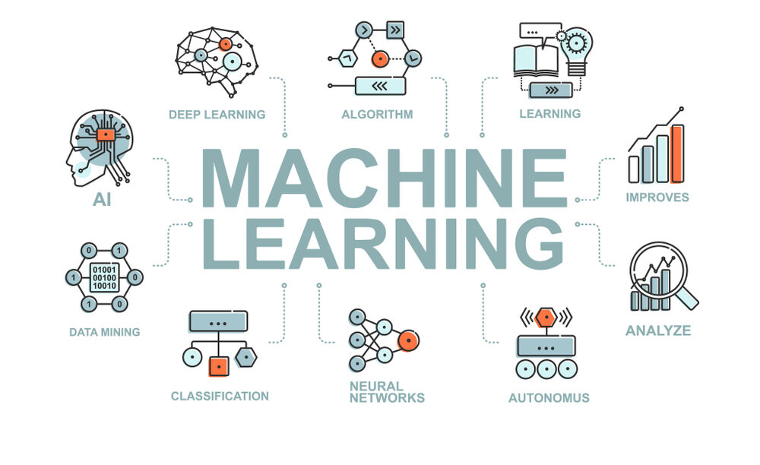
Objective of The Project:
Detect Lung Cancer: Successful detection of lung cancer.
Percentage of Accuracy: Accurate result up to acceptable accuracy.
Cost Friendly : Cost effective, affordable.
Widely Useable for Medical Institutions : Develop a system which can be widely and easily used.

Slide 5




Software Used
Anaconda
Google Colab
Visual Studio Code
TensorFlow

Slide 6
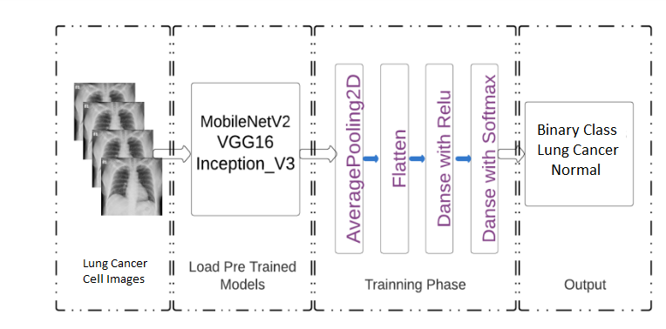
Model Applied : VGG16(Sequential)
VGG16 is a convolution neural network (CNN) architecture that’s considered to be one of the best vision model architectures to date. Instead of having a large number of hyper-parameters, VGG16 uses convolution layers with a 3x3 filter and a stride 1 that are in the same padding and maxpool layer of 2x2 filter of stride 2. It follows this arrangement of convolution and max pool layers consistently throughout the whole architecture. In the end it has two fully connected layers, followed by a softmax for output. The 16 in VGG16 refers to it has 16 layers that have weights. This network is a pretty large network, and it has about 138 million (approx) parameters.

Slide 7
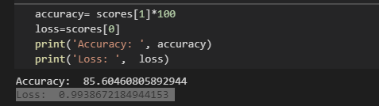
Model Evaluation
Result
Accuracy: 85.60460805892944
Loss: 0.9938672184944153
State : Normal
Precision : 0.86
Recell : 1.00
F1 Score : 0.97

Slide 8

Conclusion
At the end of our project results will be found with precision
Improved accuracy: Deep learning models can analyze large amounts of data and identify patterns that are difficult for humans to detect. This can lead to more accurate predictions of cancer diagnosis and prognosis.
Personalized treatment: Deep learning models can analyze patient data and predict which treatments are most effective for specific individuals. This can lead to more personalized and effective treatment plans.

Slide 9

Conclusion
Early detection: Deep learning algorithms can analyze medical imaging data and detect early signs of cancer that may be missed by human observers. This can lead to earlier detection and treatment, which can improve patient outcomes.
Reduced costs: By accurately predicting cancer diagnosis and prognosis, deep learning algorithms can help reduce unnecessary medical procedures and testing, which can lower healthcare costs.

